Slide 1
Lecture 17: Homework #6 Review, More on Arrays
Reading: Chapter 7, 7.3 - 7.4

Slide 2
Homework #6 Review

Slide 3
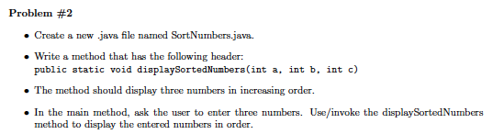
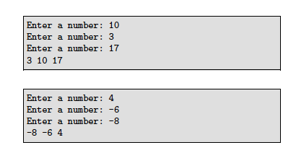

Slide 4
public static void main(String[] args)
{
Scanner kb = new Scanner(System.in);
int num1, num2, num3;
System.out.print("Enter a number: ");
num1 = kb.nextInt();
System.out.print("Enter a number: ");
num2 = kb.nextInt();
System.out.print("Enter a number: ");
num3 = kb.nextInt();
displaySortedNumbers(num1, num2, num3);
}
public static void displaySortedNumbers(int a, int b, int c)
{
if (a < b && b < c)
System.out.println(a + " " + b + " " + c);
else if (a < c && c < b)
System.out.println(a + " " + c + " " + b);
else if (b < a && a < c)
System.out.println(b + " " + a + " " + c);
else if (b < c && c < a)
System.out.println(b + " " + c + " " + a);
else if (c < a && a < b)
System.out.println(c + " " + a + " " + b);
else
System.out.println(c + " " + b + " " + a);
}

Slide 5
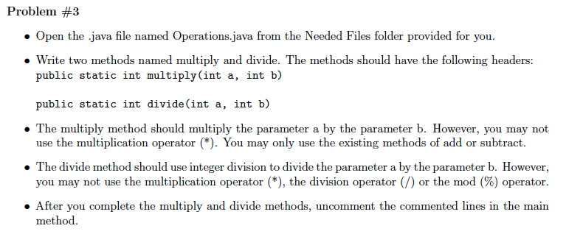


Slide 6
public static void main(String[] args)
{
int c = 3729, d = 22, e = 34, f = 67;
//System.out.println(e + " * " + f + " is " + multiply(e, f));
//System.out.println(c + " / " + d + " is " + divide(c, d));
}
public static int add(int a, int b)
{
return a + b;
}
public static int subtract(int a, int b)
{
return add(a, -1 * b);
}
public static int multiply(int a, int b)
{
int sum = 0;
for (int i = 1; i <= b; i++)
{
sum = add(sum, a);
}
return sum;
}

Slide 7
public static void main(String[] args)
{
int c = 3729, d = 22, e = 34, f = 67;
//System.out.println(e + " * " + f + " is " + multiply(e, f));
//System.out.println(c + " / " + d + " is " + divide(c, d));
}
public static int add(int a, int b)
{
return a + b;
}
public static int subtract(int a, int b)
{
return add(a, -1 * b);
}
public static int divide(int a, int b)
{
int sub = a;
int i = 0;
while (sub >= b)
{
i++;
sub = subtract(sub, b);
}
return i;
}

Slide 8
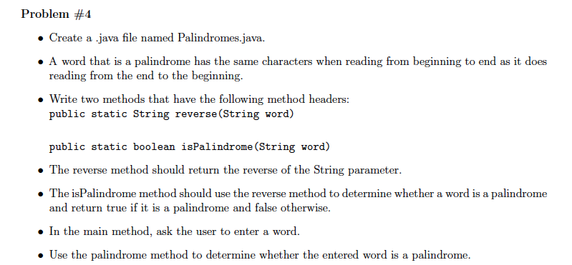



Slide 9
public static void main(String[] args)
{
System.out.println("Enter a word: ");
String input = kb.nextLine();
if (isPalindrome(input))
System.out.println(input + " is a palindrome");
else
System.out.println(input + " is not a palindrome");
}
public static String reverse(String word)
{
String reverseWord = "";
for (int i = word.length() - 1; i >= 0; i--)
{
reverseWord += word.charAt(i);
}
return reverseWord;
}
public static boolean isPalindrome(String word)
{
String reverse = reverse(word);
int count = 0;
boolean matches = true;
while (matches && count < word.length())
{
if (word.charAt(count) != reverse.charAt(count))
matches = false;
count++;
}
return matches;
}

Slide 10
Review of Arrays
How do you declare an integer array named intList?
int[] intList;
How do you declare an character array named charList?
char[] charList;
How do you declare and create an integer array named intList to be of size 10?
int[] intList;
intList = new int[10];
int[] intList = new int[10];

Slide 11
Review of Arrays
How do you declare and create an character array named charList to be of size 29?
char[] charList;
charList= new char[29];
char[] charList = new char[29];
How do you declare, create and initialize a character array named charList to be of size 6
and contain the letters ‘d’, ‘a’, ‘l’, ‘l’, ‘a’, ‘s’?
char[] charList = {‘d’,’a’,’l’,’l’,’a’,’s’};
char[] charList = new char[6];
charList[0] = ‘d’;
charList[1] = ‘a’;
charList[2] = ‘l’;
charList[3] = ‘l’;
charList[4] = ‘a’;
charList[5] = ‘s’;
OR

Slide 12
Review of Arrays
What do you typically use for processing arrays?
for-loops!!
Print out each value of the array below using a for-loop.
Do not separate the characters with spaces.
char[] charList = {‘d’,’a’,’l’,’l’,’a’,’s’};
for (int val = 0; val < charList.length; val++)
{
S.O.P(charList[val]);
}
What is printed out?
dallas

Slide 13
Review of Arrays
Print out each value of the array below using a for-loop.
int[] intList = new int[5];
intList[0] = 4;
intList[1] = 8;
intList[2] = 1;
for (int num = 0; num < intList.length; num++)
{
S.O.P(intList[num] + “ “);
}
What is printed out?
4 8 1 0 0

Slide 14
Arrays and User Input
Want to write the code that lets a user enter 7 numbers and then stores the 7 numbers
in an array.
But...we only want to print out the request once.
Enter 7 numbers: 7 13 27 5 9 1 21
Memory
i: 0
array: {0, 0, 0, 0, 0, 0, 0}
Scanner kb = new Scanner(System.in);
System.out.print(“Enter 7 numbers: ”);
int[] array = new int[7];
for (int i = 0; i < array.length; i++)
{
array[i] = kb.nextInt();
}
1
2
3
4
5
6
7
{7, 0, 0, 0, 0, 0, 0}
{7, 13, 0, 0, 0, 0, 0}
{7, 13, 27, 0, 0, 0, 0}
{7, 13, 27, 5, 0, 0, 0}
{7, 13, 27, 5, 9, 0, 0}
{7, 13, 27, 5, 9, 1, 0}
{7, 13, 27, 5, 9, 1, 21}

Slide 15
Example: Above or below average
Create a .java file named AboveBelowAverage that generates 100 random numbers.
Find the sum of the numbers and then the average. Then, for each number, print
out whether it is below the average or above the average.
Notes:
We want 100 random numbers. We need to use (int) (101 * Math.random())
We have to store the numbers because we’re going to print each one out. Should use an array of size 100.

Slide 16
public static void main(String[] args)
{
int[] numbers = new int[100];
for (int i = 0; i < numbers.length; i++)
{
numbers[i] = (int) (101 * Math.random());
}
double sum = 0;
for (int i = 0; i < numbers.length; i++)
{
sum += numbers[i];
}
System.out.println("The sum is " + sum);
double average = sum/numbers.length;
System.out.println("The average is " + average);
for (int i = 0; i < numbers.length; i++)
{
if (numbers[i] < average)
System.out.println(numbers[i] + " is less than the average.");
else
System.out.println(numbers[i] + " is greater than the average.");
}
}

Slide 17
Example
Create a java file named Cards that will pick four cards at random from a deck of 52 cards.
Notes:
There are 13 Spades, 13 Hearts, 13 Diamonds, 13 Clubs
Instead of trying to create an array that holds 52 values (tedious!), let’s create an array for the suits and an array for the ranks.
String[] suits = {“Spades”, “Hearts”, “Diamonds”, “Clubs”};
String[] ranks = {“Ace”, “2”, “3”, “4”, “5”, “6”, “7”, “8”, “9”, “10”, “Jack”, “Queen”, “King”};

Slide 18
public static void main(String[] args)
{
String[] suits = {"Spades", "Hearts", "Diamonds", "Clubs"};
String[] ranks = {"Ace", "2", "3", "4", "5", "6", "7", "8","9", "10", "Jack", "Queen", "King"};
int randNum1, randNum2;
String suit, rank;
for (int card = 1; card <= 4; card++)
{
System.out.print("Card " + card + " is: " );
randNum1 = (int) (4 * Math.random());
randNum2 = (int) (13 * Math.random());
suit = suits[randNum1];
rank = ranks[randNum2];
System.out.println(rank + " of " + suit);
}
}

Slide 19

Read Sections 7.3 - 7.4
Homework #7 is posted and
due Wednesday, November 12th.
Don’t forget that you have a
quiz on methods Monday!

